Slide 1
CS 211 Computer Architecture Lecture 4: Beyond Moore’s Law
Ravi Mittal
ravi.mittal@iitgoa.ac.in
Indian Institute of Technology, Goa

Slide 2
References
Chapter 1 - Computer Abstractions and Technology - Patterson and Hennessy
High Performance Computer Architecture Challenges – Class presentation, Rajeev Balasubramonian, School of Computing, University of Utah
From Single Core to multi-core: Preparing for new exponential, Paper, by Jeff Parkhurst, John Darringer, Bill Grundmann, IEEE Explore, ICCAD 2006: 67-72
Making Sense of Recent Researchin Temperature-Aware Design, Presentation, Kevin Skadron, Univ. of Virginia

Slide 3
Last class

Slide 4
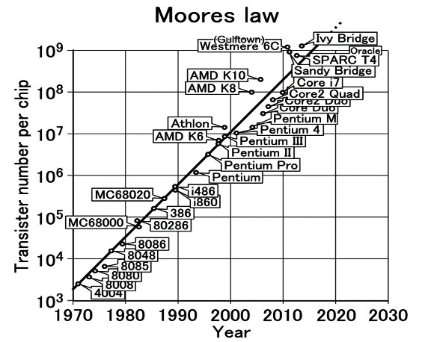
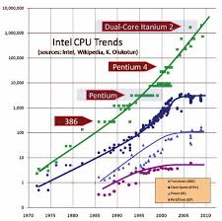
Moore’s Law
The number of transistors on a chip doubles about every 18-24 months
Gordon Moore, co-founder of Intel, 1965
True for 50+ years

Slide 5
Interpretation
Transistor count is increasing per Moore’s law
Currently Microprocessor chips contain 10 Billion to 60 Billion transistors
Apple M1 (year 2020): 16 Billion Transistors : 5 nm wide
about 25 silicon atoms
Nvidia GA 100 Ampere (year 2020): 54 Billion transistors: 7 nm
Samsung DRAM eUFS (1 TB) (year 2020): 8Tb; 2048 Billion Transistors
Number of cores is increasing (why?)
The way to utilize increase in transistors –> use multiple cores

Slide 6
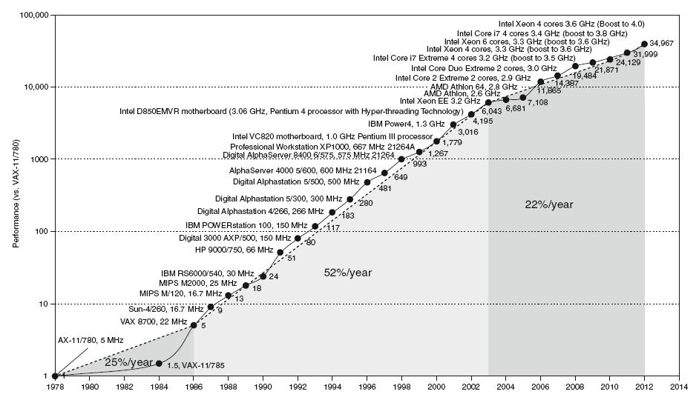
Uniprocessor Performance
Constrained by power, instruction-level parallelism, memory latency
Chart plots performance relative to the VAX 11/780

Slide 7
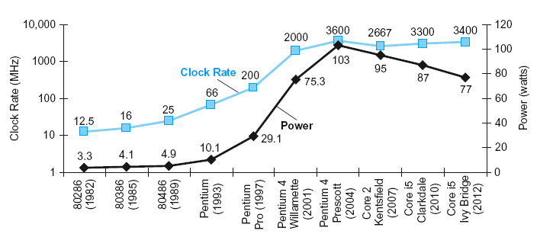
Power and Clock Rate - Trend
In CMOS IC technology
Chapter 1 — Computer Abstractions and Technology — Patterson and Hennessy

Slide 8
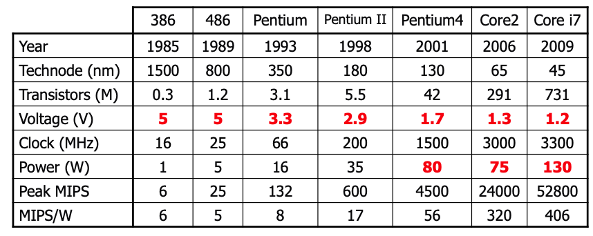
Trend in Power
Supply voltage is decreasing over time; 5 V → 1 V
“Voltage scaling” is reaching it’s limit
Clock frequency – not much increase

Slide 9
In the class we will study
Clock Speed improvements – and Processor design
Power Wall
Moving to Multicore Architecture
Dynamic Power and Thermal Management
Ongoing work (self reading)

Slide 10
Clock Speed Improvement – Processor Design

Slide 11
Increase in Clock Speed
Microarchitecture must be able to do meaningful work in each clock cycle
Microarchitecture uses pipeline architecture

Slide 12
The Basic Pipeline
Consider an automobile assembly line:
Stage 1
Stage 2
Stage 3
Stage 4
A new car
rolls out
every day
1 day
1 day
1 day
1 day
A new car
rolls out every
half day
In each case, it takes 4 days to build a car, but…
More stages → more parallelism and less time
between cars

Slide 13
What Determines Clock Speed?
Clock speed is a function of work done in each stage – in the earlier examples, the clock speeds were 1 car/day and 2 cars/day
Similarly, it takes plenty of “work” to execute an instruction and this work is broken into stages
250ps → 4GHz clock speed
Execution of a single instruction

Slide 14
Clock Speed Improvements
Why have we seen such dramatic improvements
in clock speed?
work has been broken up into more stages
transistors have been becoming faster
as technology improves, we can draw smaller and smaller transistors/gates on a chip and that improves their speed

Slide 15
Will these Improvements Continue?
Transistors will continue to shrink and become faster for some more years
Each pipeline stage is already pretty small –improvements from this factor will cease

Slide 16
Power Wall

Slide 17
Power Consumption
Power (per unit time) = Dynamic Power + Static Power
Dynamic power ∼ capacitance x voltage² x frequency
Leakage Power ~ Voltage x Leakage Current
Lecture notes: Unit 12 CS 501Computer Architecture – Prof Milo Martin, Univ of Pennsylvania
Notes:
Energy = power x time = (dynpower + lkgpower) x time

Slide 18
Dynamic Power P_{dynamic}
It is Switching or active power
Energy to switch a gate (0 to 1, 1 to 0)
Each gate has capacitance C
Charge stored is ~ C * V
Energy to charge/discharge a capacitor is ~ to C * V²
Time to charge/discharge a capacitor is ~ to V
Result: frequency ~ to V
P_{dynamic} ~ a*C*V² *f ~ a*C*V³
C: capacitance per transistor (size of transistors)
V: voltage (supply voltage for gate: Vdd)
f: frequency (transistor switching freq. is ~ to clock freq.)
a: activity factor (not all transistors may switch this cycle)

Slide 19
Static Power
aka idle or leakage power
Transistors don’t turn off all the way → Transistors “leak”
P_{leak} ~ V*I_{leak}
V: voltage
I_{leak} is the current that flows through transistors even when they are off
P_{leak} increases with the number of transistors on a chip
It is increasing – as per Moore’s law
Use of materials (other than silicon) and circuit level technology – limit the effect of leakage
Hence, the focus is on reduction of dynamic power – which also reduces leakage power

Slide 20
Reducing Dynamic Power
Target each component: P_{dynamic} ~ a*C*V² *f
Reduce Capacitance
Smaller size has smaller capacitance
Integration is reducing value of C: Capacitance of a transistor
Reduce Voltage
Quadratic reduction in energy consumption
But also slows transistors (transistor speed is ~ to V)
V can’t be reduced – as it will increase leakage current
Currently it is around 0.9 – 1 V

Slide 21
Reducing Dynamic Power
Reduce frequency (f)
Slower clock frequency (reduces power but not energy)
Yes. However it will reduce performance
Frequency wall: : can’t figure out how to increase clock frequency without unreasonable increase in power
Reduce Activity (a)
Clock gating disable clock to unused parts of chip
Don’t switch gates unnecessarily
Power Wall
Air cooling capped at ~150W (thermal design power - TDP)
Today: some chips are already thermally limited
Moore’s Law is providing area that a single thread can’t economically use

Slide 22
What are the limitatons?
Every generation transistor feature size reduces by 0.7
Area reduces by 0.49 = 0.5
Assuming frequency remains flat
Pn ≅ CV²f ⇒ 0.7 (1²) (1) = 0.7 P
Power reduces by 0.7
Power density = Pn/A = 0.7/0.5 = 1.4
And this is very optimistic, because C probably scales more like 0.8 or 0.9, and we want frequency to go up, so a more likely number is 1.5-1.75X
So, even if we keep the same frequency and voltage, every generation increase power density by 1.5 times

Slide 23
Moving to Multicore Architecture

Slide 24
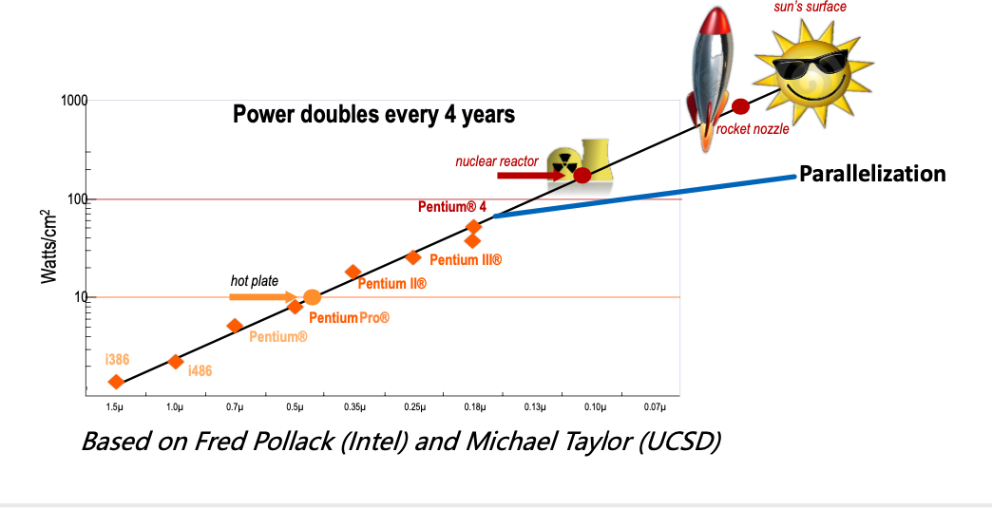
If power density continues to increase and chip size remains the same..
No “free lunch” for software developers, must consider:
Parallel systems

Slide 25
Towards Multicore..
If we keep %-area dedicated to all the cores the same -- total power goes up by same factor
But max TDP for air cooling is expected to stay flat
Around 200-250 W total and around 1.5 W/mm²
Multicore allows power to scale linearly with # cores
The shift to multicore does not eliminate the wall
But heat/power can be managed within limits in each core

Slide 26

Low-Fat Cores???
PClaes Oldenburg, Apple Core – Autumn http://www.greenwicharts.org/pastshows.asp

Slide 27
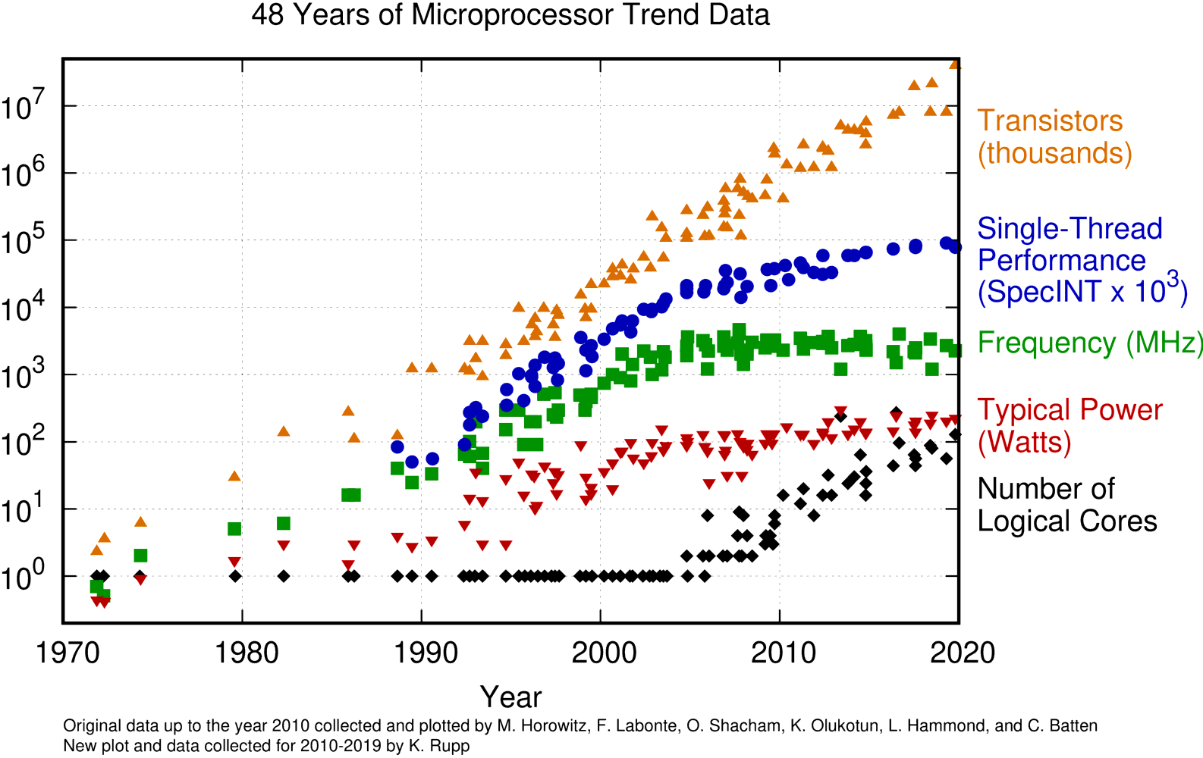
Moore’s Law → Multiple cores
https://www.karlrupp.net/2015/06/40-years-of-microprocessor-trend-data/

Slide 28
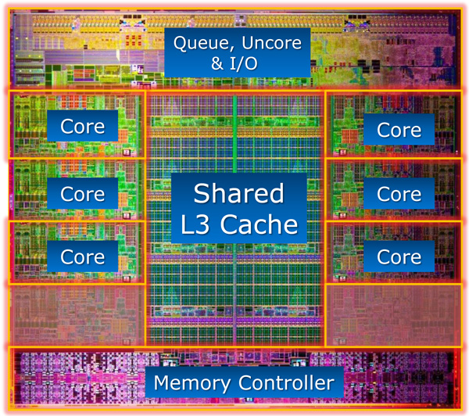
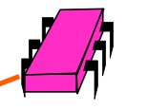
An example of Modern Chip Microprocessor
All on
The same
chip
Sandy Bridge E die
https://www.anandtech.com/show/5091/intel-core-i7-3960x-sandy-bridge-e-review-keeping-the-high-end-alive

Slide 29
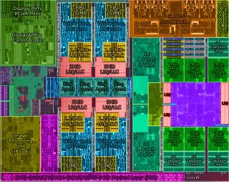
Intel’s Tiger Lake (Sept 2020)

Slide 30
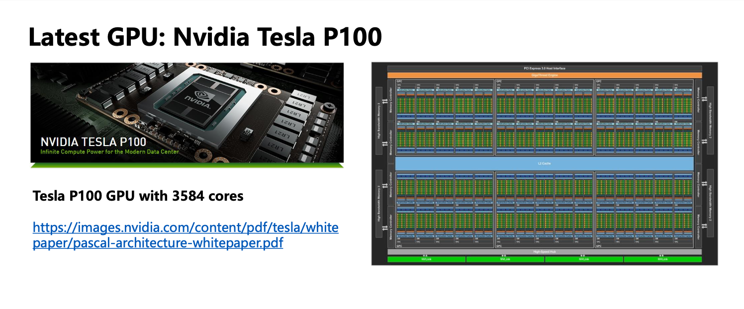
GPU

Slide 31
Dynamic Power and Thermal Management

Slide 32
Dynamic Power and Thermal Management
A lot of research happening in this area
Two primary ways
Increase/Reduce Supply voltage
Reduce activity
Techniques
Monitoring
Monitoring for thermal management
Take temperature readings – with thermal sensors on chip
Monitoring for power – not as easy as that of thermal
Triggering of an action – by comparing with some threshold
Take actions

Slide 33
Dynamic Voltage Frequency Scaling (DVFS)
Dynamically trade-off power for performance
Change the voltage and frequency at runtime under control of OS
Reduction in voltage will reduce frequency
Note that P_{dynamic} ~ V³
Reduce V and f linearly
Cubic decrease in dynamic power
Linear decrease in performance (due to slower clock)
Linear decrease in static power
Only modest static energy improvement
Most systems are designed for the peak performance – which is not always needed
Some parts of chip can run at a slower speed without affecting the outcome (without missing deadlines)

Slide 34
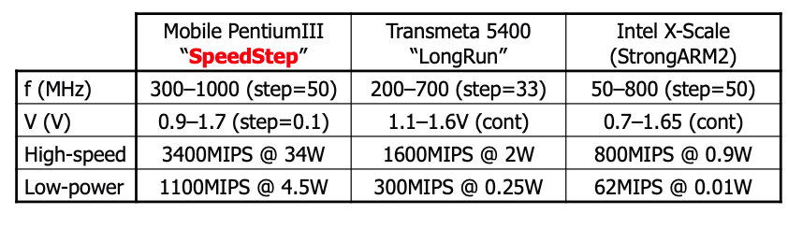
Dynamic Voltage Frequency Scaling
Dynamic voltage/frequency scaling
Favors parallelism
Example: Intel Xscale
Can vary he voltage in a continuous fashion
1 GHz to 200 MHz reduces energy used by 30x
But around 5x slower
5 x 200 MHz in parallel → uses 1/6th the energy
Power is driving the trend toward multi-core

Slide 35
DVFS technique (Continued)
Example Mobile device
No need to apply DVFS – when mobile is plugged in
When it is on battery, we can apply DVFS
Example Advanced Laptops
Scaling can be done – task by task basis ( via OS) or within a task
Some microprocessor (eg Pentium 4) stops execution for short period of time – to manage thermal dissipation

Slide 36
Resource Adaptation
Hibernation mode of Laptops – OS feature
Dumps the processor state and contents of volatile memory to the hard disk
Power offs the system
Restarting (after hibernation state) – restoration of the earlier state
Faster than a complete restart
Hibernation of some parts of a computer
Disk or Display
OS can monitor disk usage and prevent disk rotation ; It powers up the disk when there is a disk request
Selective turning off and on of different parts of computers

Slide 37
Class Summary
Moore’s law – Number of transistors are doubling every 18-24 months – almost doubling computing power every 2 – 3 years with the same amount of $
No free lunch for programmers in future
Integration is hitting power wall
Power consumed = Dynamic Power + Static Power
P_{dynamic} ~ N*C*V² *f*A
P_{static} ~ N*V*e^{–Vt}
Due to heating constraints
a processor can’t accommodate more transistors → more heat
Reduce voltage to approx 1 V
Reduce frequency
Dynamic Voltage and Frequency scaling
Technology is moving towards Multicore architecture

Slide 38
Backup: Ongoing Work

Slide 39
Three Big Limits
Design and Manufacturing
Material limits, design methodology
Speed of Light
Imposes size/speed trade-off
Power Management
Inefficiency adds up

Slide 40
Today's Solutions
Design Changes
Multiple Processors, active power management, new computer architectures
Interconnection Improvements
3D interconnections
Layout optimization, optical transmission
New Materials
Gallium arsenide, carbon

Slide 41
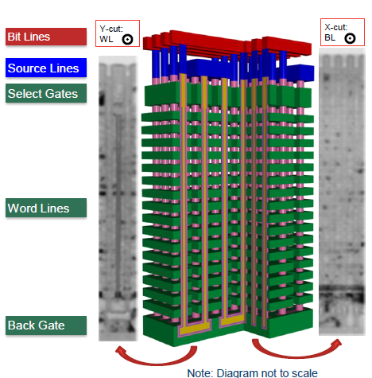
3D Interconnections
Allows for shorter critical paths
Denser circuit layouts
Samsung Technology Development

Slide 42
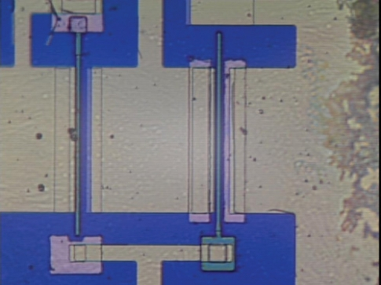
Gallium Arsenide Logic
Slowly developing, becoming competitive with silicon
Difficult to work with, but emerging technologies- promising
Combines well with optical interconnects
Compound Semiconductor

Slide 43
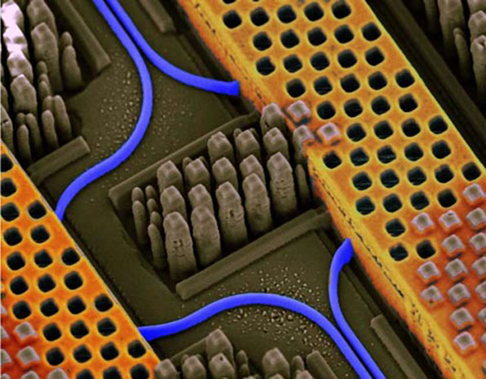
Optical Interconnections
Faster, more efficient than copper
Easier to multiplex
Combines well with GaAs logic
IBM Research

Slide 44
Power vs Energy
Energy tells us the true “cost” of performing a fixed task
Power (energy/time) poses constraints; can only work fast
enough to max out the power delivery or cooling solution
If processor A consumes 1.2x the power of processor B, but finishes the task in 30% less time, its relative energy is 1.2 X 0.7 = 0.84;
Processor A is better, provided that 1.2x power can be supported by the system

Slide 45
Problem 1
For a processor running at 100% utilization at 100 W,
20% of the power is attributed to leakage. What is the
total power dissipation when the processor is running at
50% utilization?
Total power = dynamic power + leakage power
= 80W x 50% + 20W
= 60W
Solve for 0% utilization; the system consumes 20W.
This is the basis for “server consolidation” in datacenters
(move processes so you have a few highly utilized servers).

Slide 46
Problem 2
If processor A consumes 1.4x the power of processor B,
but finishes the task in 20% less time, which processor
would you pick:
(a) if you were constrained by power delivery constraints?
Proc-B
(b) if you were trying to minimize energy per operation?
Proc-A is 1.4x0.8 = 1.12 times the energy of Proc-B
(c) if you were trying to minimize response times?
Proc-A is faster, but we could scale up the frequency
(and power) of Proc-B and match Proc-A’s response
time (while still doing better in terms of power and
energy)

Slide 47
Problem 2
If processor A consumes 1.4x the power of processor B,
but finishes the task in 20% less time, which processor
would you pick:
(a) if you were constrained by power delivery constraints?
(b) if you were trying to minimize energy per operation?
(c) if you were trying to minimize response times?

Slide 48
Reducing Power and Energy
Can gate off transistors that are inactive (reduces leakage)
DFS: Dynamic frequency scaling -- only reduces frequency and dynamic power
DVFS: Dynamic voltage and frequency scaling – can reduce voltage and frequency by (say) 10%; can slow a program by (say) 8%, but reduce dynamic power by 27%, reduce total power by (say) 23%, reduce total energy by 17%

Slide 49
Problem 3
Processor-A at 3 GHz consumes 80 W of dynamic power
and 20 W of static power. It completes a program in 20
seconds.
What is the energy consumption if I scale frequency down
by 20%?
What is the energy consumption if I scale frequency and
voltage down by 20%?

Slide 50
Moore’s law: Enablement of new era
People carry smart phone in their pocket
More powerful than the biggest computer made in 1995
Slender laptops, Streaming video, social media, search, the cloud, smart devices, and the Internet, computers in automobiles, WWW, Human Genome project, social engineering, Online entertainment

Slide 51
Reducing Static Power
P_{static} ~ N*V*e^{–Vt}
Reduce the number of transistors (N)
Use fewer transistors/gate
Disable transistors
Power gating disable power to unused parts of chip
Power down units (or entire core) not being used
Long latency to power up
Reduce Voltage (V)
Linear reduction in static energy consumption
But also slows down transistors (transistor speed is ~ V)
Dual V_{t} – Use mix of high and low V_{t} transistors
Use slow low leak transistors in SRAM
Low-leakage transistors

